Slide 1


Department of Computer Engineering DBS [CA] PPT topic Delivered By: Bhavesh Anandpara
Class R. No: 510 PRN No: 2046491245010

Slide 2

TUPLE RELATIONAL CALCULUS ( TRC )
Introduction
Procedural Query Language
Query specification involves giving a step by step process of obtaining the query result. e.g., relational algebra
Usage calls for detailed knowledge of the operators involved
Difficult for the use of non-experts.

Slide 3
TUPLE RELATIONAL CALCULUS ( TRC )
Introduction
Declarative Query Language
Query specification involves giving the logical conditions the results are required to satisfy.
Easy for the use of non-experts

Slide 4
TRC – a declarative query language
Tuple variable – associated with a relation
( called the range relation)
Takes tuples from the range relation as its values
t: tuple variable over relation r with scheme R(A,B,C)
T.A stands for value of column A etc.

Slide 5
TRC Query – a basic form
{ t1.Aij.t2Ai2…tm.Aim | 0 }
0 -> predictive calculus expression involving tuple variables
t1,t2,…tm, tm+1…ts
- specifies the condition to be satisfied

Slide 6
Interpretation of the query in TRC
All possible tuple assignments to the free variable in the query are considered.
For any Specific assignment, if the expression to the right of the vertical bar evaluates to true, that combination of tuple values would be used to produce a tuple in the result relation

Slide 7
Interpretation of the query in TRC
While producing the result tuple, the values of the attributes for the corresponding tuple variables as specified on the left side of the vertical bar would be used.
Note: The only free variables are the ones that appear to the left of the vertical bar.

Slide 8
Example Relational Schema
student( rollNo, name, degree, year, sex, deptNo, advisor)
department( deptId, name, hod, phone)
professor( empId, name, sex, startYear, deptNo, phone)
course( courseId, cname, credits, deptNo)
enrollment( rollNo, courseId, sem, year, grade)
teaching( empId, courseId, sem, year, classRoom)
prerequisite( prereqCourse, courseID)

Slide 9
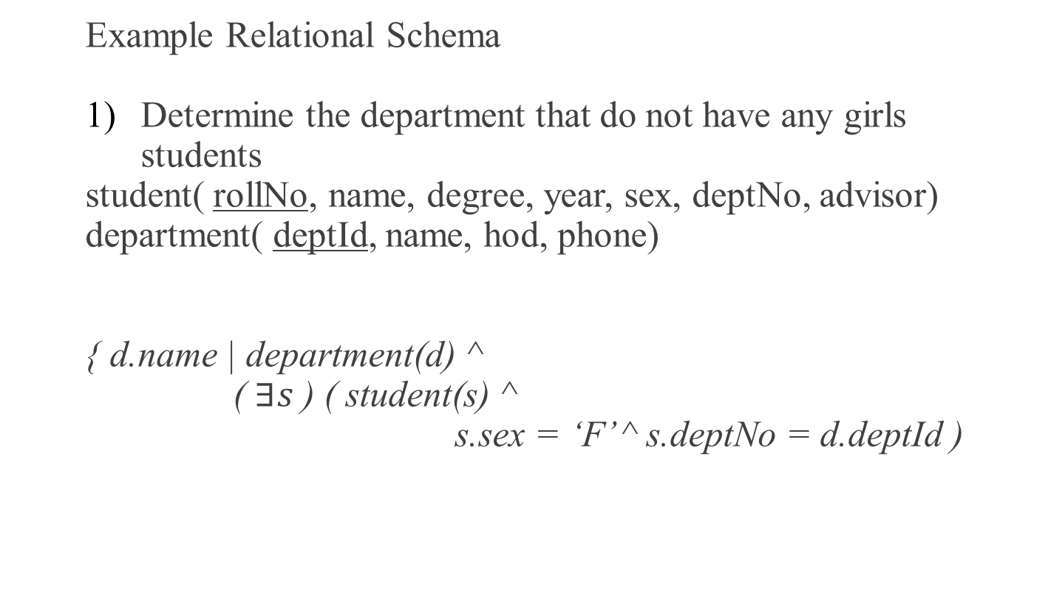
Example Relational Schema
Determine the department that do not have any girls students
student( rollNo, name, degree, year, sex, deptNo, advisor)
department( deptId, name, hod, phone)
{ d.name | department(d) ^
( $∃s$) ( student(s) ^
s.sex = ‘F’ ^ s.deptNo = d.deptId )

Slide 10
Problems with unrestricted use of Negation
What is the result of the query:
{ s.rollNo | ~ student(s) } ?
Infinite Answers ??

Slide 11
Problems with unrestricted use of Negation
Unsafe TRC expression :
Any expression whose results uses “constants/values” that do not appear in the instances of any of the database relations.
Unsafe expressions are to be avoided while specifying TRC
queries.

Slide 12
Expressive power of TRC and Relational Algebra
It can be shown that
both tuple relational calculus and relational algebra
have the same expressive power
A Query can be formulated in ( safe ) TRC
if and only if it can be formulated in RA

Slide 13
Expressive power of TRC and Relational Algebra
Both cannot be used to formulate queries involving transitive closure
-- find all direct or indirect pre-requisites of a course
-- find all subordinates of a specific employee etc.

Slide 14
Reference
THANK YOU

